Slide 1
Types of Societies from hunter gatherer to post industrial

Slide 2
questions
How do people make a living in different types of society?
Why some unrelated societies show similar characteristics?

Slide 3
Types of Society
Foraging
Horticulture (Food producing societies)
Agriculture, (Food producing societies)
Pastoralism (Food producing societies)
industrialism.

Slide 4
Food Foraging
Foraging—an economy and way of life based on hunting and gathering—was humans’ only way of making a living until about 12,000 years ago, when people began experimenting with food production.

Slide 5
Food Foraging
Before the domestication of plants and animals, all people supported themselves through food foraging.
a mode of subsistence involving some combination of hunting, fishing, and gathering wild plant foods.

Slide 6
Food Foraging
Most hunting and gathering cultures, however, have been destroyed or absorbed by the spread of Western culture (the culture of Europe, the United Sta tes, Australasia) .

Slide 7
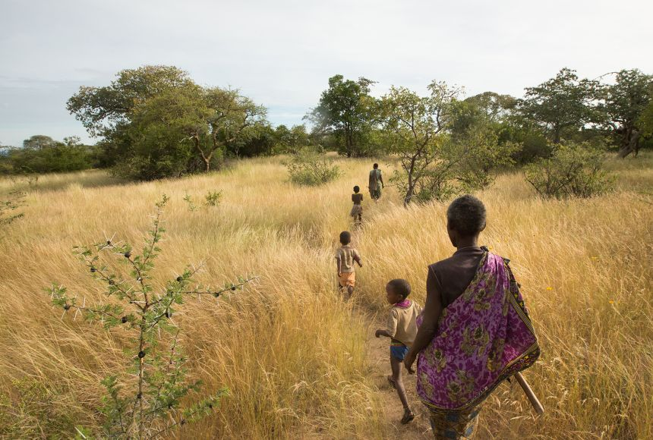
Characteristics of Food Foraging
Rely on nature:
People rely on nature to make their living. They don’t grow crops or breed and tend animals.

Slide 8
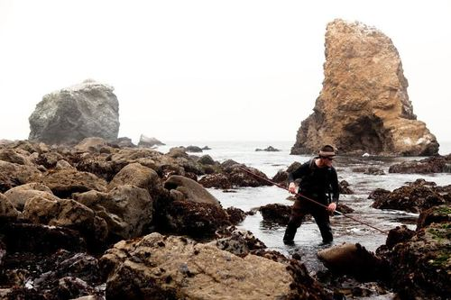
Characteristics of Food Foraging
Example, on the North Pacific Coast of North America, foragers could draw on varied sea, river, and land species, such as salmon and other fish, sea mammals, berries, and mountain goats

Slide 9
Characteristics of Food Foraging
Movement:
Food foragers move as needed within a circumscribed (restricted) region that is their home range to tap into naturally available food sources.

Slide 10
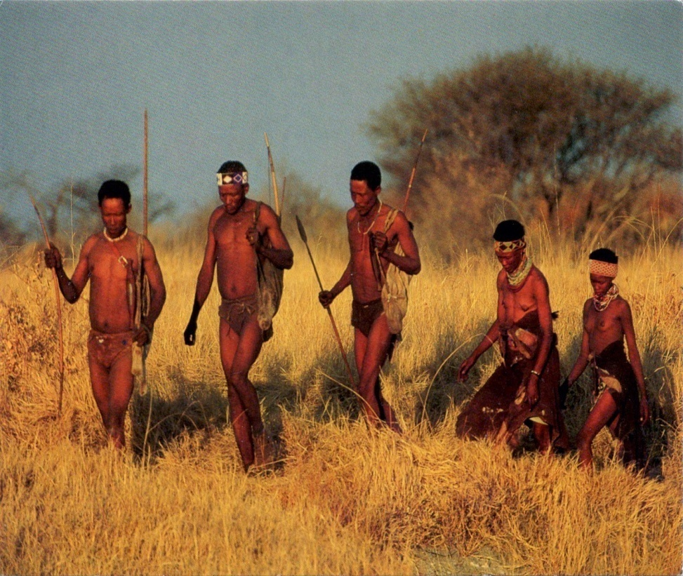
Characteristics of Food Foraging
the Ju/’hoansi in the Kalahari Desert of southern Africa, who depend on the reliable and highly drought-resistant mongongo nut, may keep to fairly fixed annual routes and cover only a restricted territory.

Slide 11
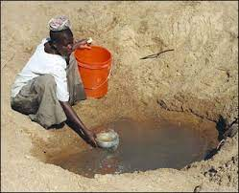
Characteristics of Food Foraging
Availability of water is essential:
A crucial factor in this mobility is availability of water.
The distance between the food supply and water must not be so great that more energy is required to fetch water than can be obtained from the food.

Slide 12
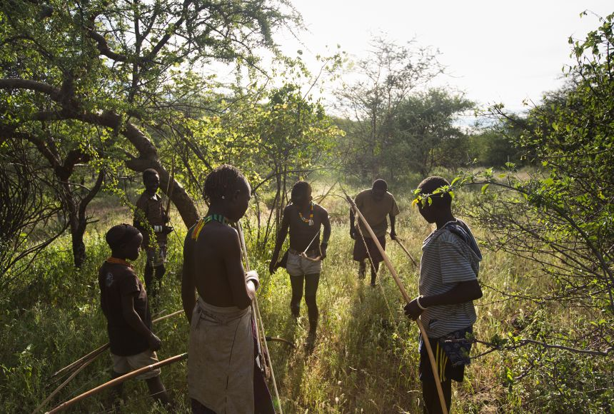
Characteristics of Food Foraging
Small group:
Another characteristic of the food-foraging adaptation is the small size of local groups, typically fewer than a hundred people.

Slide 13
Characteristics of Food Foraging
It may be more adaptive for a group to keep its numbers low rather than to expand indefinitely and risk destruction by a sudden and unexpected natural reduction in food resources.

Slide 14
Characteristics of Food Foraging
Ample and Balance Diet:
Anthropological research shows that forager diets are typically ample and balanced and that foragers are less likely to experience severe famine than farmers.
The material possessions of foragers may be limited, but so is their desire to a mass things.

Slide 15
Characteristics of Food Foraging
Leisure Time:
They have plenty of leisure time for concentrating on family ties, social life, and spiritual development—apparently far more than people living in farming and industrial societies.
Such findings clearly challenge the once widely held view that food foragers live a miserable existence.

Slide 16
Number of foragers at present
Today at most a quarter of a million people—less then 0.001 percent of the world population of about 6 billion—still support themselves mainly as foragers.

Slide 17
Anthony Giddens
Hunters and gatherers are not merely 'primitive' peoples whose ways of life no longer hold any interest for us. Studying their cultures allows us to see more clearly that modern institutions are far from being 'natural' features of all human life. Of course, we should not idealize the circumstances in which hunters and gatherers have lived, but, nonetheless, the absence of war, the lack of major inequalities of wealth and power and the emphasis on cooperation rather than competition are all instructive reminders that the world created by modern industrial civilization is not necessarily to be equated in any obvious way with 'progress

Slide 18
Food producing societies

Slide 19
Food producing societies
The domestication of plants and animals began about 12,000 years ago.
It led to radical transformations in cultural systems.
Producers developed new social and economic patterns based either on plant cultivation or pastoralism.

Slide 20
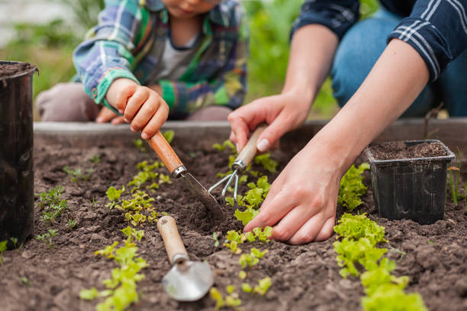
Horticulture
Horticulture is an adaptive system in which small communities of gardeners work with simple hand tools, using neither irrigation nor the plow.

Slide 21
Horticulture
A horticultural way of life involves producing enough food for the group’s subsistence.
They often can (and sometimes do) produce more than they need for purposes such as inter-village feasts and exchange.
Horticulturists do not produce a surplus to sell on the market

Slide 22
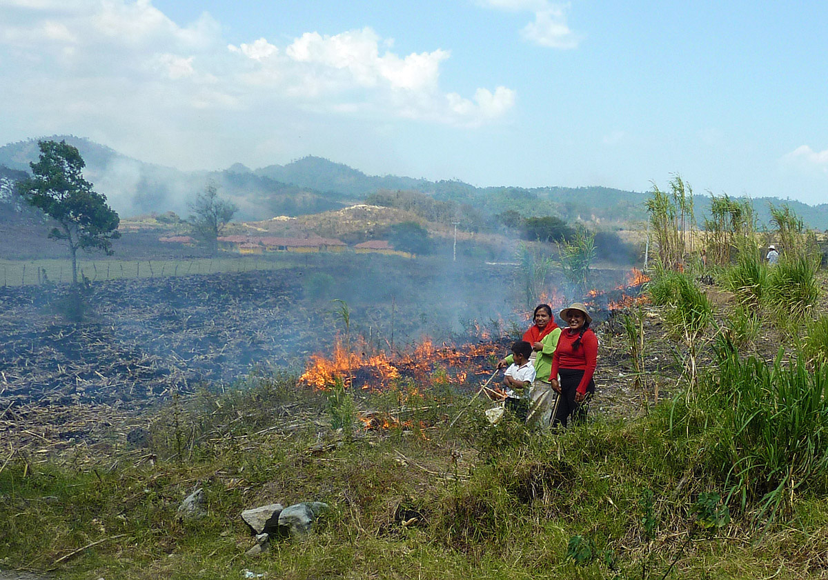
Horticulture (example)
Horticulturalists typically rely on slash-and-burn techniques. Farmers clear land by cutting down (slashing) trees, saplings, and brush.
Then they burn that vegetation. They also may set fire directly to grasses and weeds on their farm plots before planting.

Slide 23
Horticulture (example)
Slashing and burning not only gets rid of unwanted vegetation, but it also kills pests and provides ashes that help fertilize the soil.
The farmers then sow, tend, and harvest their crops on the cleared plot.
Kuikuru of the South American tropical forest relied on horticulture for long time.

Slide 24
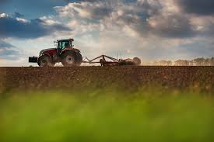
Crop cultivation: Agriculture
In contrast to horticulture, agriculture is crop cultivation that involves using technologies other than hand tools, such as
irrigation
fertilizers, and
the wooden or metal plow pulled by harnessed draft animals

Slide 25
Crop cultivation: Agriculture
In the so-called developed countries of the world, it relies on fuel-powered tractors to produce food on larger plots of land.

Slide 26
Crop cultivation: Agriculture
In contrast to horticulturists, agriculturists are able to grow surplus food—providing not only for their own needs but for those of various full-time specialists and nonproducing consumers as well.

Slide 27
Crop cultivation: Agriculture
This surplus may be sold for cash, or it may be coerced out of the farmers through tribute, taxes, or rent paid to landowners.
Example, USA, Bangladesh, India

Slide 28
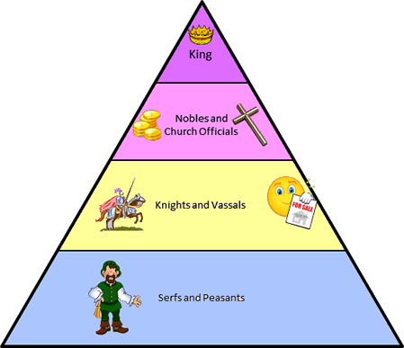
Feudalism
Feudalism was a form of society based on ownership of land. Unlike today's farmers, vassals under feudalism were bound to cultivating their lord's land.
In exchange for military protection, the lords exploited the peasants into providing food, crops, crafts, homage, and other services to the landowner.

Slide 29
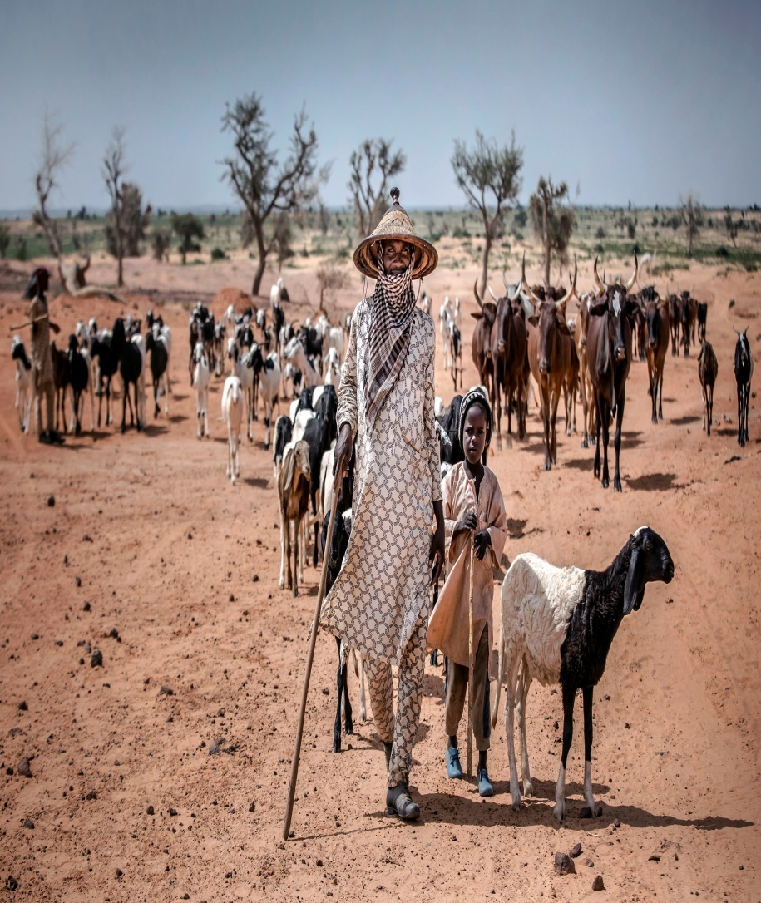
Pastoralism
Herders, or pastoralists, are people whose activities focus on such domesticated animals as cattle, sheep, goats, camels, and reindeer.
They live in northern and sub-Saharan Africa, the Middle East, Europe, and Asia.

Slide 30
Pastoralism
Herders attempt to protect their animals and to ensure their reproduction in return for food (dairy products and meat) and other products, such as leather.

Slide 31
Pastoralism
People use livestock in various ways.
Natives of North America’s Great Plains, for example, didn’t eat, but only rode, their horses.
For Plains Indians, horses served as “tools of the trade.”

Slide 32
Pastoralism
Many pastoral societies still exist in the modern world, concentrated especially in areas of Africa, the Middle East and Central Asia.
These societies are usually found in regions where there are dense grasslands, or in deserts or mountains.

Slide 33
Pastoralism
Pastoral societies usually migrate between different areas according to seasonal changes.
Given their nomadic habits, people in pastoral societies do not normally accumulate many material possessions.

Slide 34
Non-industrial civilization
From about 6000 BCE onwards, we find evidence of larger societies than ever existed before.
The development of cities.
Very pronounced inequalities of wealth and power and were associated with the rule of kings or emperors.

Slide 35
Industrial society
With the invention of the steam engine in England, which brought about an industrial revolution that quickly spread to other parts of the globe.
Machines and tools powered by water, wind, and steam (followed by oil, gas, and diesel) replaced human labor and hand tools, increasing factory production and facilitating mass transportation.

Slide 36
Industrial society
Throughout the 1800s and 1900s, this resulted in large-scale industrialization of many societies.
Technological inventions utilizing oil, electricity, and nuclear energy (since the 1940s) brought about more dramatic changes in social and economic organization on a worldwide scale.

Slide 37
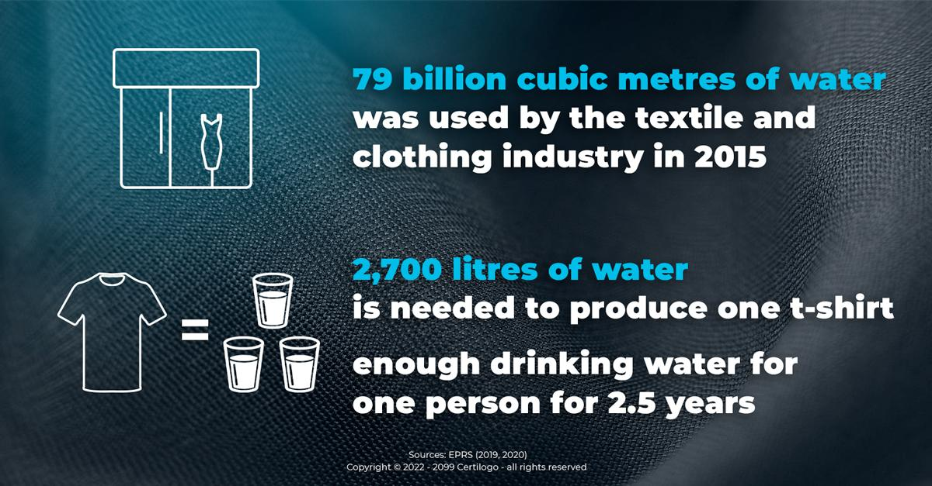
Industrial society
A large majority of the employed population work in factories. offices or shops rather than in agriculture.
Majority people live in towns and cities, where most jobs are to be found and new job opportunities are created.
Mass production, environmental degradation.

Slide 38
Post-Industrial society
In the late 20th century, the electronic digital revolution made the production and distribution of information the center of economic activity in some wealthy societies.

Slide 39
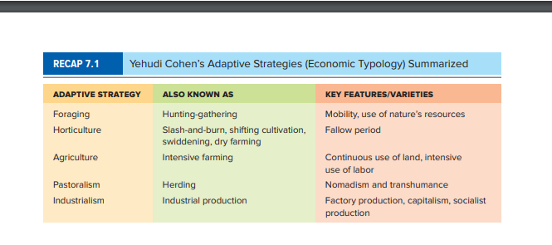

Slide 40
Thank you

